Slide 1
Architecture - Mimir and Tyle
GitHub
https://github.com/mimir-org
Code packages
https://www.nuget.org/packages?q=mimirorg
https://www.npmjs.com/search?q=mimirorg
Docker images
https://hub.docker.com/u/mimirorg
Notes:
I will give you a brief overview of the architecture and thoughts for Tyle and Mimir.
We have already settled down a minimum temporary community, that will take this project further.
We have called it Mimirorg for the lack of a better name. We try to share all our work through different channels.
You will find all of code and documentation from this Git organization.
Shared code is distributed through NPM and NuGet.
All applications is shared through Dockerhub.

Slide 2
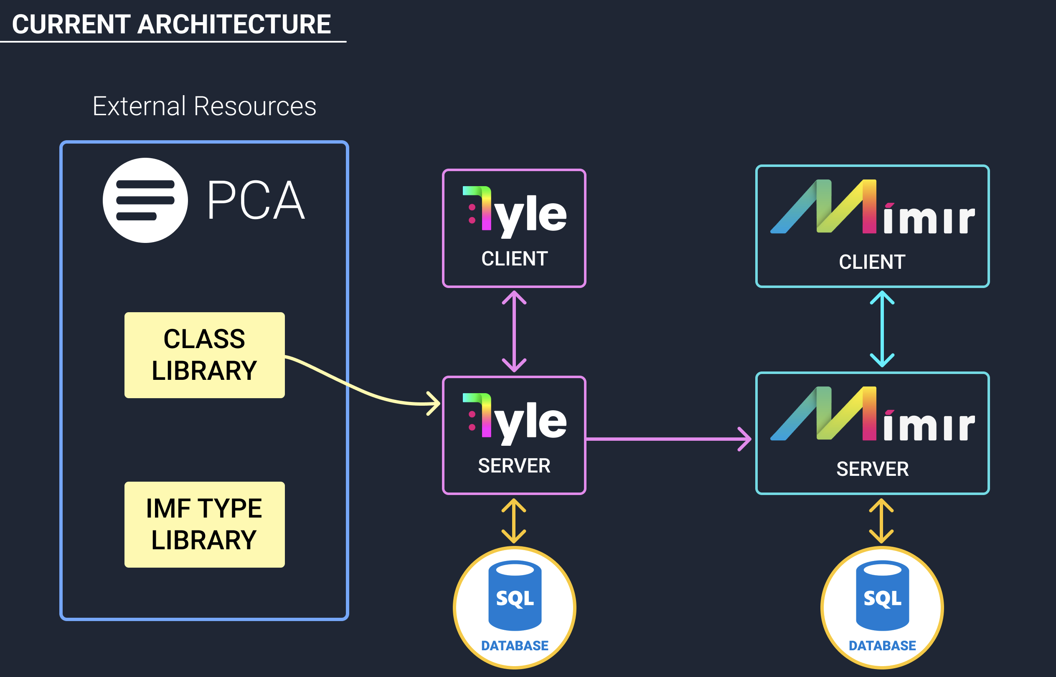
Notes:
Tyle and Mimir has a React client and a .Net backend application.
You can find more information about the technology stack at the GitHub repository.
Each application has a SQL backup store.
It is important to understand that Tyle is not another ontology solution, but rather an application that can consume ontologies and create drawing tools for other applications and specially Mimir.
Today we are consuming data from PCA. We have implemented a SPARQL web-client, that fetch data from PCA. In this first stage we are linking attribute definitions, unit of measurement, Quantities, Range or Quantity datums and Range datums.
Tyle will run as a separate instance and serve all Mimir applications. This because we want to reuse types across the industry.
Think about Tyle as a template editor, and not a type-editor. Some of these templates could also possibly become types or IMF types.
Mimir is the application that using the types to do facility work.

Slide 3
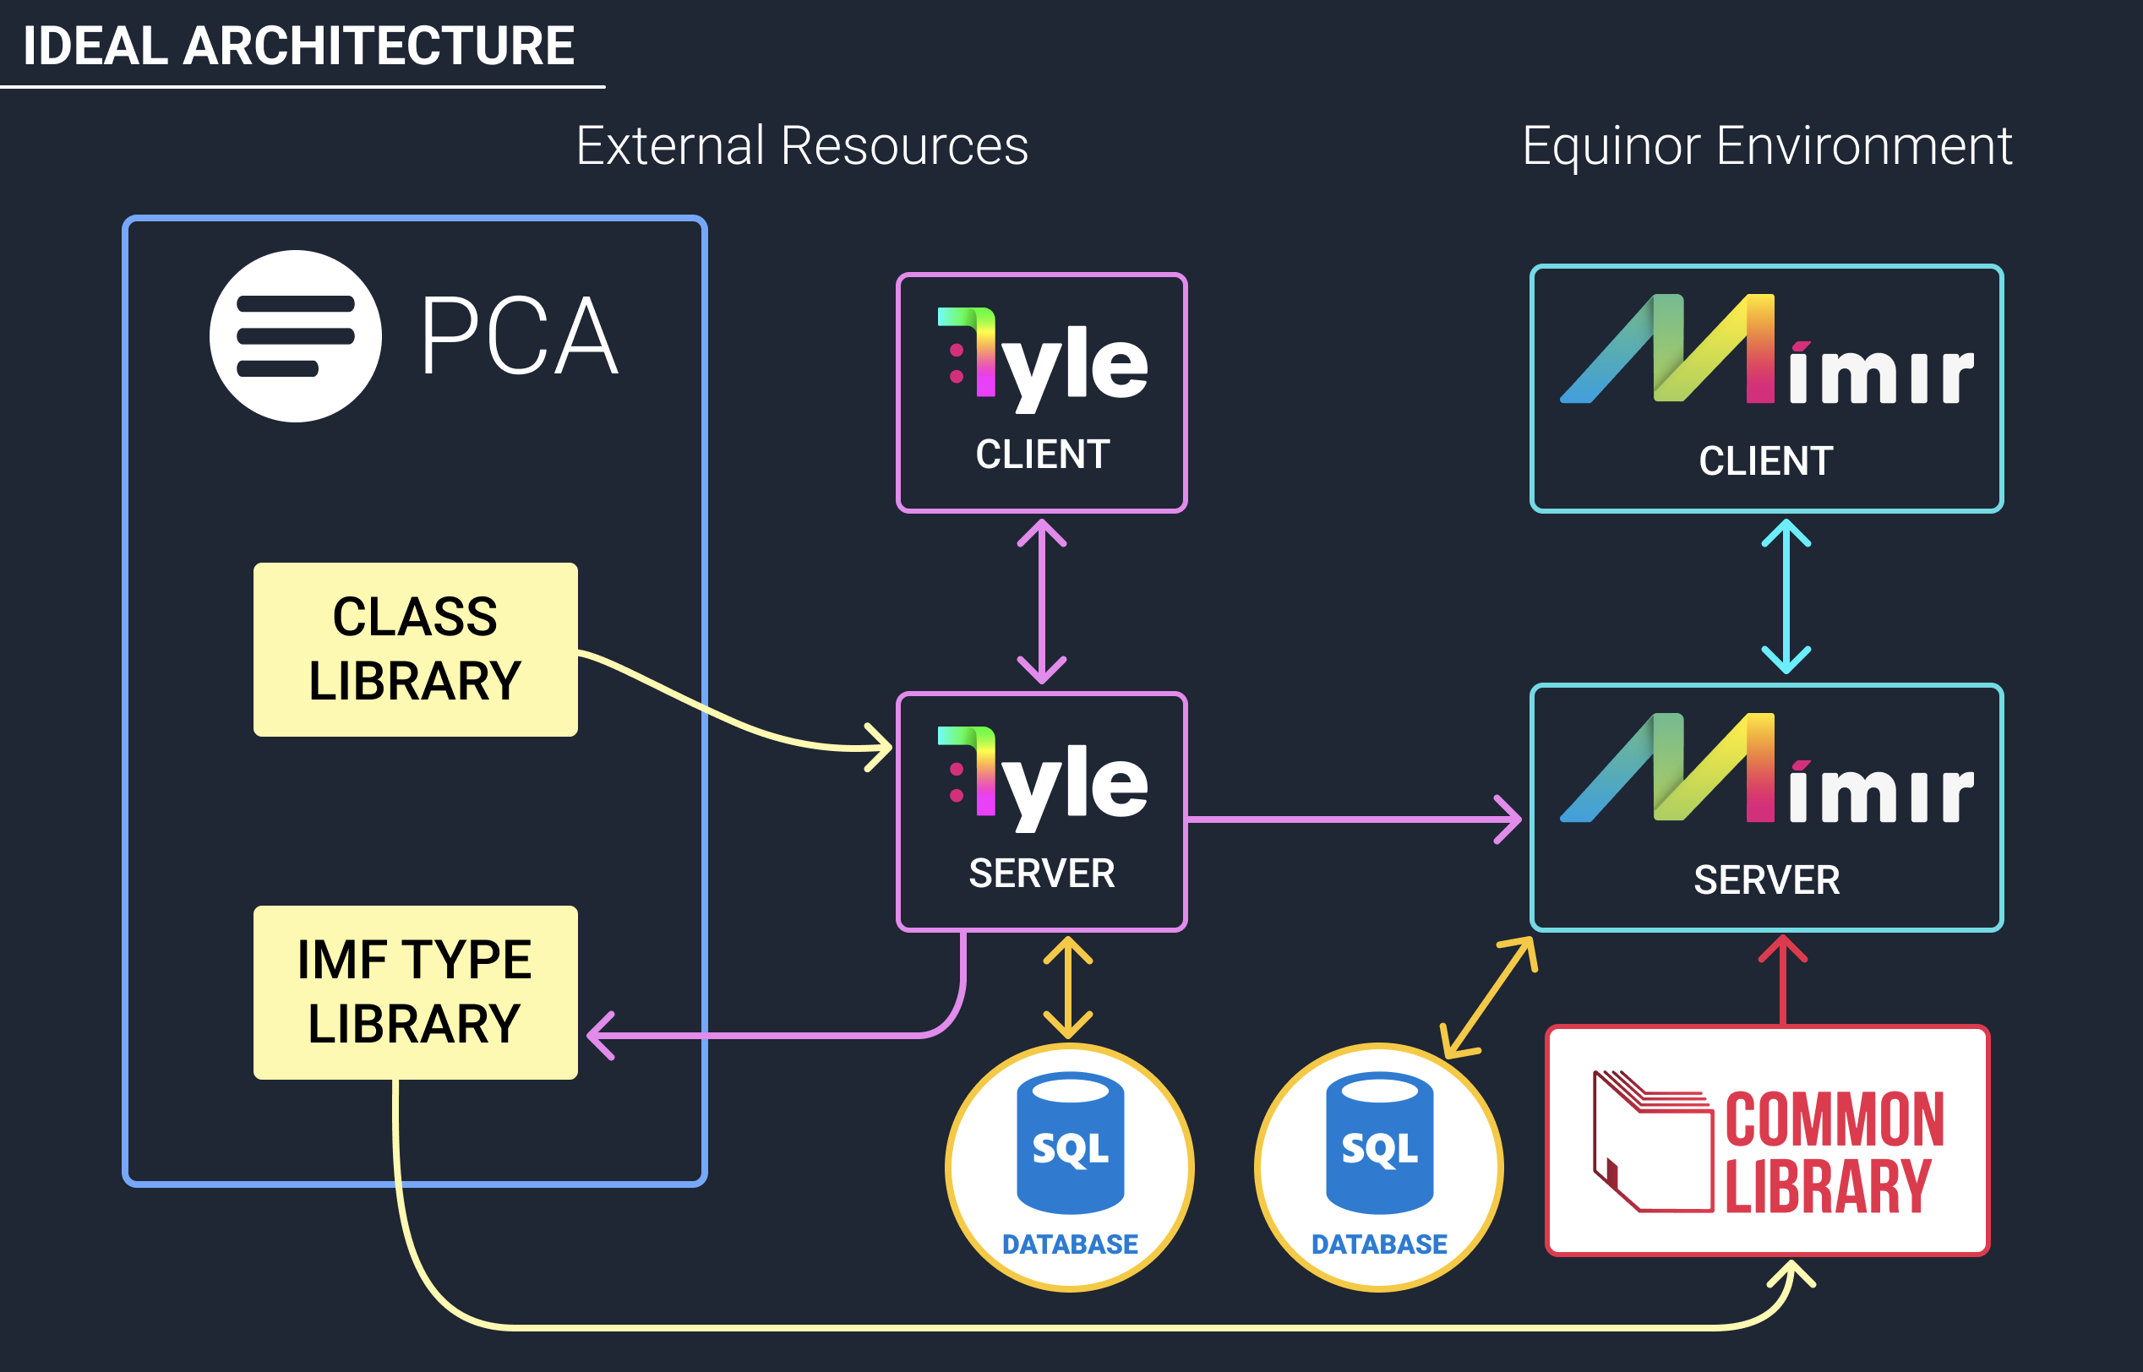
Notes:
In the future, we wish to send combined data back to the PCA library as IMF types as shown in the drawing.
Also in the future, we wish to include Equinor’s Common Library as an internal source for data. Our code is structured in a way that makes it possible to include other sources.
At the present time we are not sure what area of responsibility Common Library will have, but I think it will have a central position in sharing IMF data.
It is important for us at this step, to not make an architecture that exclude other sources in the future.

